Slide 1
Estimation of prevention-effective CAB-LA concentrations among MSM/TGW in HPTN 083
Brett Hanscom*, Mark A. Marzinke, Robert Bies, Deborah J. Donnell, Craig Hendrix, Xinnong Li, Zhe Wang, Carolina Acuipil, Alex Rinehart, James F. Rooney, Lydia Soto-Torres, Marybeth McCauley, Beatriz Grinsztejn, Raphael J. Landovitz
*Fred Hutch Cancer Center, Seattle, WA, USA
CROI 2025, 3/12/2025

Slide 2
Financial Disclosures
Nothing to disclose

Slide 3
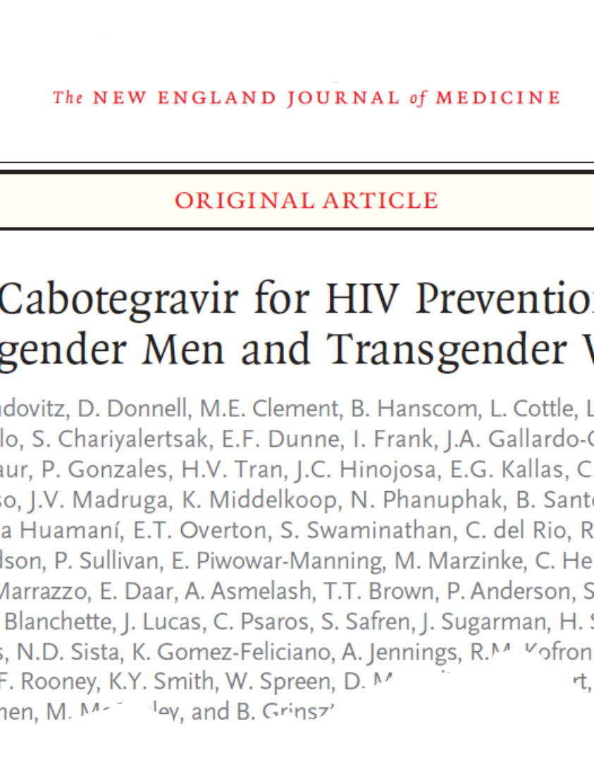
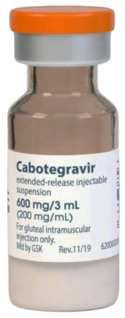
Introduction
HIV Prevention Trials Network (HPTN) 083 demonstrated that Cabotegravir (CAB) is highly effective for HIV prevention and superior to TDF/FTC in men who have sex with men (MSM) and transgender women (TGW).
The study regimen consisted of daily oral 30mg tablets for 5 weeks, followed by two 600mg IM injection 4 weeks apart and 600mg injections every 8 weeks thereafter for a maximum of 3 years.
Landovitz R et al. NEJM. 2021.

Slide 4
Objective
Objective: Estimate the plasma CAB concentration associated with protection against HIV infection in HPTN 083
Challenges:
  The trial only studied a single treatment regimen.
  CAB concentrations assessed at discrete, sparse time points
  HIV-exposure and infection timing unknown

Slide 5
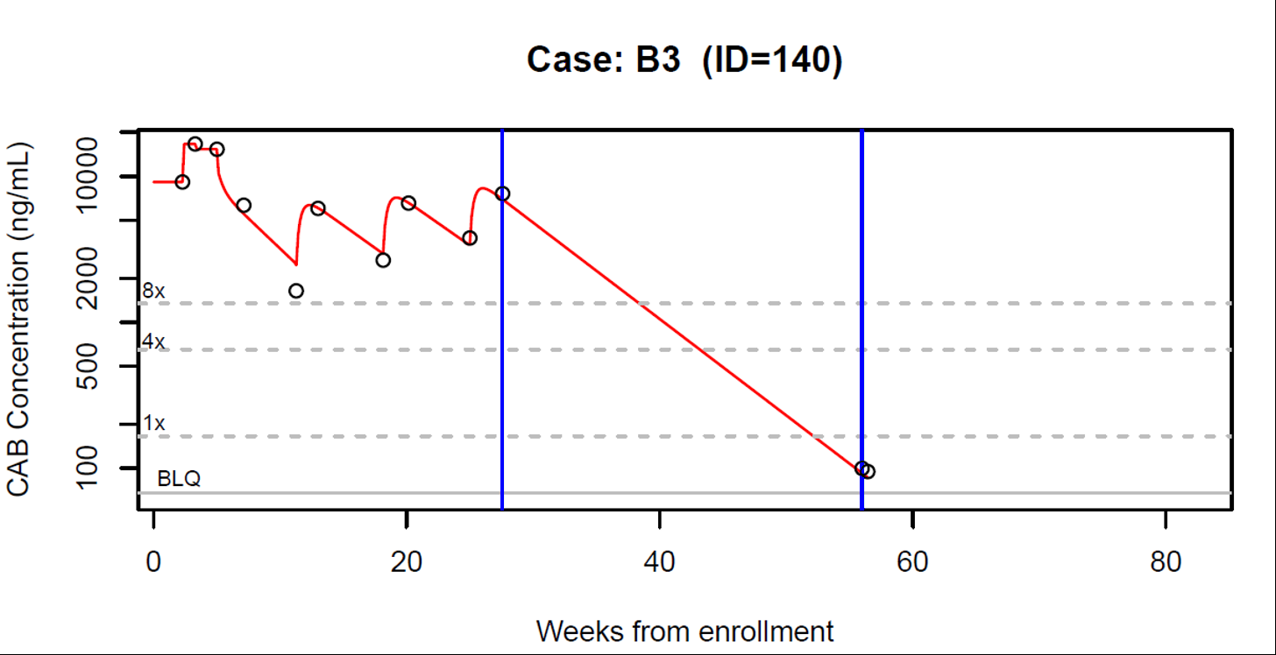
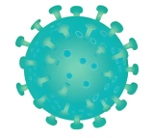
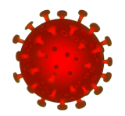
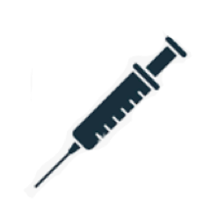

Example / Challenges
Oral Lead In
?
HIV
?
HIV
Injection Period
Last HIV Negative
First HIV Positive*
Infection Window
*Architect Ag/Ab testing, Geenius IFA confirmatory testing, m2000 Abbott quantitative viral load testing with a LLOQ of 40 c/mL, and Hologic Aptima Qualitative viral load testing; on select cases SCA (single copy assay) viral load .

Slide 6
Nested Case-Control Design
Cases: all incident HIV cases from the primary and year-one analyses whose infection occurred within 3 years from enrollment
Controls: selected at a 4:1 ratio
Matching factors
  Region (Africa, Asia, Latin America, US)
  Gender identity (Cisgender MSM, TGW)
  Race (Black, Non-black)
  Duration of follow-up at least as long as the case prior to detection¹ of HIV
Final count: 25 cases, 99 controls²
¹ First-positive HIV date as determined by sensitive testing at the central lab and confirmed by the EAC.
² One of the initially selected control participants later was found to be HIV-positive and was excluded from the analysis.

Slide 7
PK Assessment / Categorization
CAB concentrations assessed in stored samples for cases and controls
Full concentration-time curves estimated for all participants
Participants classified according to CAB concentrations during the infection window

Slide 8
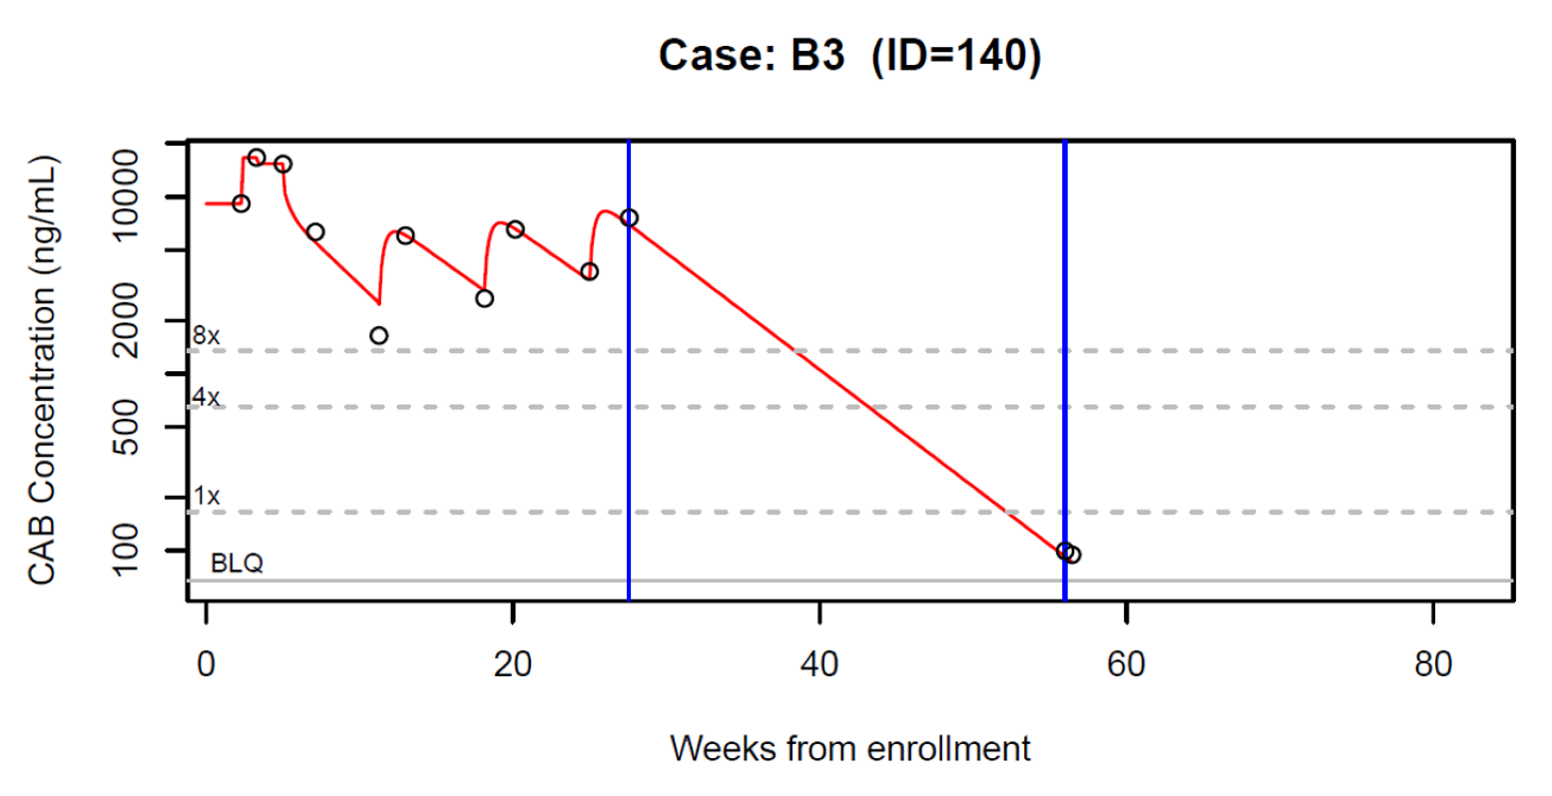
CAB Exposure Categories
Classification according to minimum CAB concentration during the infection window:
1. Above 4x PA-IC₉₀ (664 ng/mL)
2. Between 1x PA-IC₉₀ and 4x PA-IC₉₀
3. Below 1x PA-IC₉₀ (166 ng/mL)

Slide 9
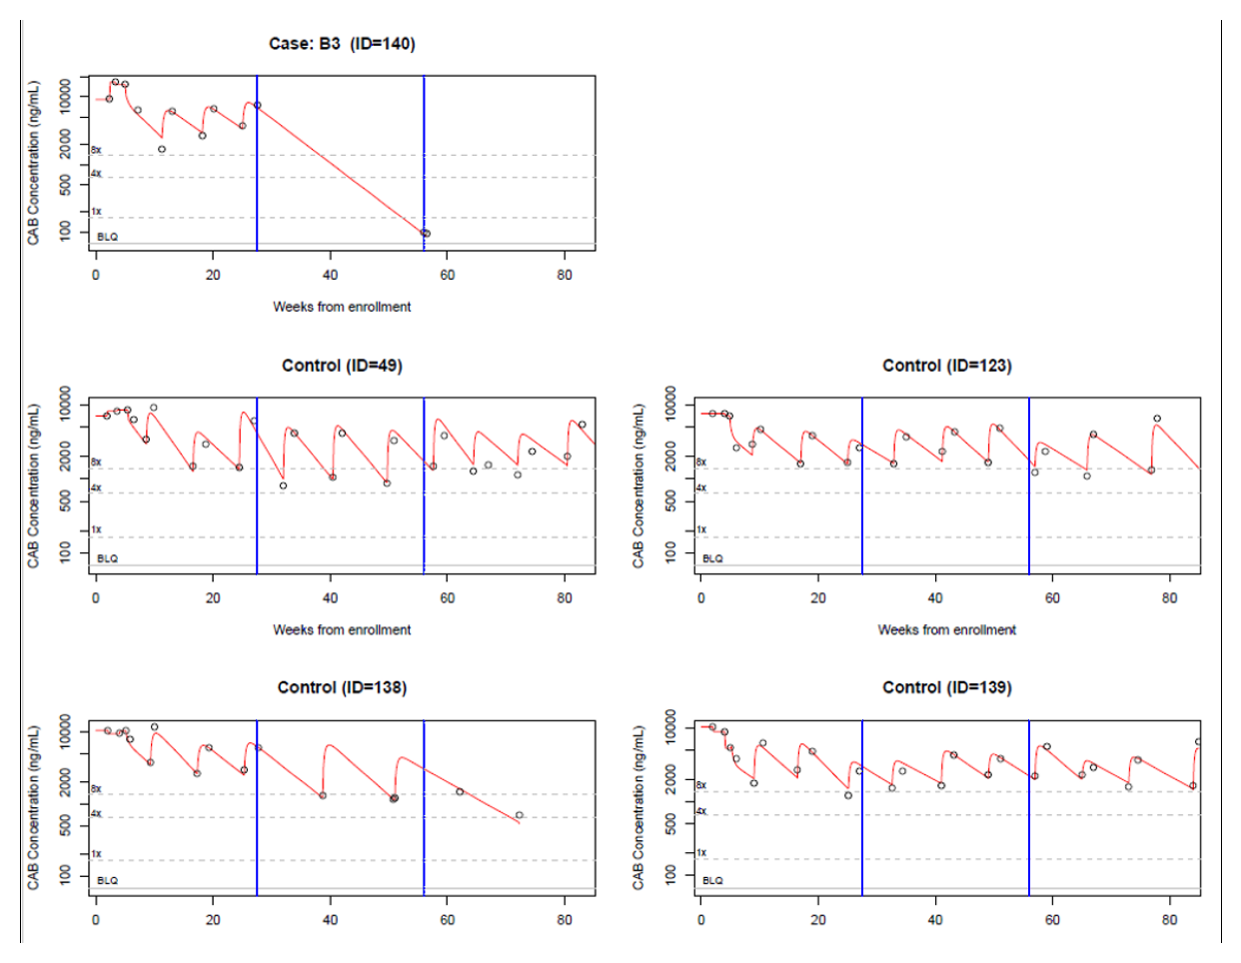
Example Case-Control Set
Minimum Below 1x PA-IC₉₀
Minimum Above 4x PA-IC₉₀

Slide 10
Results
Minimum plasma CAB during acquisition window | Cases (n=25) n (%) | Controls (n=99) n (%) | Risk Reduction (95% CI)
< 1x PA-IC₉₀ | 16 (64) | 14 (14) | (ref)
≥ 1x PA-IC₉₀ and < 4x PA-IC₉₀ | 2 (8) | 10 (10) | 79 (-20, 96)
≥ 4x PA-IC₉₀ | 7 (28) | 75 (76) | 93 (77, 98)

Slide 11
Conclusions
The approved 8-weekly 600mg dosing has been shown to reliably achieve CAB above 4x PA-IC₉₀ (664 ng/mL)
We observe a strong, statistically significant association between CAB concentrations above 4x PA-IC₉₀ and HIV protection
  These results are consistent with non-human primate model results
CAB LA is estimated to provide over 90% reduction in the probability HIV acquisition among MSM and TGW

Slide 12
Acknowledgments
Sponsors
HPTN 083 Study Team
Community Program Managers
Community Educators & Recruiters, CAB Members
Our 43 study sites in 7 countries
And most of all, our study participants
U.S. National Institute of Allergy and Infectious Diseases (NIAID), National Institute of Mental Health (NIMH), National Institute on Drug Abuse (NIDA), and the National Institute of Child Health and Human Development (NICHD) all components of the U.S. National Institutes of Health (NIH)
Additional funding from ViiV Healthcare
HIV Prevention Trials Network (HPTN)
Laboratory Center (Johns Hopkins University)
SCHARP (Fred Hutchinson Cancer Research Center)
Leadership and Operations Center (FHI360)
Pharmaceutical Support
ViiV Healthcare
Gilead Sciences, Inc.
| @HIVptn

